Slide 1
Capstone Project - The Battle of Neighborhoods: Crime in Vanouver Submitted by: Gowri Subramanian Date: March 2020

Slide 2
Introduction
Vancouver, a bustling west coast seaport in British Columbia, is among Canada’s densest, most ethnically diverse cities. A popular filming location, it’s surrounded by mountains, and also has thriving art, theatre and music scenes. Vancouver Art Gallery is known for its works by regional artists, while the Museum of Anthropology houses preeminent First Nations collections.
According to bc.ctvnews.ca, Assaults and overall violent crime: There were 4,521 reported assaults in 2019, compared to 4,064 in 2018. Due to that increase, Vancouver's overall crime rate was up 7.2 per cent. The number of "shots-fired incidents," as described by police, was up last year to 29 calls – 10 more than reported in 2018.

Slide 3
Problem Statement: The idea of this study is to help people planning to settle either temporarily in Vancouver by renting a house or to settle permanently by buying a house so that they would be able to choose a safer location and stay and feel safe by providing data about the safe and unsafe areas, predominant type of crime as well as the crime trend over years in various regions.
Objective:
This project aims to select the safest and least safest areas in Vancouver based on the total crimes, explore the venues in these areas and finally using the decision tree classifier. This report will be targeted to the People who are looking to analyze crime incidents, as the city continues to be a leader in so many fields. The crime statistics will provide an insight for the people towards their approach in buying or renting houses in different areas of city. The most common venues in the safest areas will be explored.

Slide 4
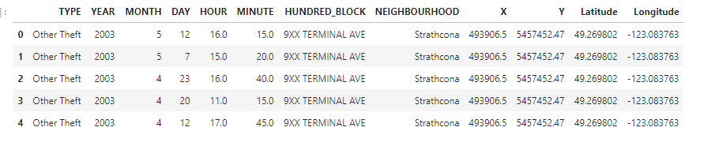
Data Set URL and the Cognitive Class Lab:
To provide the stakeholders the necessary information I'll be downloading .csv file from https://www.kaggle.com/wosaku/crime-in-vancouver and used https://labs.cognitiveclass.ai/tools/jupyterlab/ to execute and show my work.

Slide 5
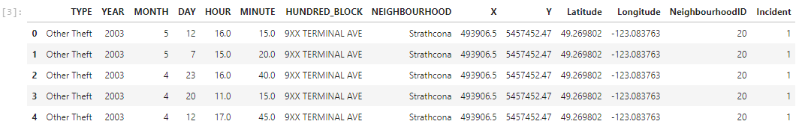
3) Methodology For this report I used a few bar graphs that could help a new investor to decide the best neighborhood to buy or rent a house in Vancouver based on its crime type, trend etc. In order to do that I've used the Kaggle platform https://www.kaggle.com/wosaku/crime-in-vancouver to derive data along with Decision Tree Classifier to predict the 2017 year along with its accuracy. Firstly, necessary libraries were imported. The Vancouver crime file.csv was loaded and it provides information about the following: TYPE, YEAR, MONTH, DAY, HOUR, HUNDRED_BLOCK, NEIGHBOURHOOD, X, Y, Latitude, and Longitude. Then, cleaning of data was done by adding a new column NeighbourhoodId by grouping .groupby method to group the neighbourhood and a new column Incident = ‘1’. Then, dropped the minute column, since theft is not checked by every minute. (by using .drop method df.drop(['MINUTE'], axis=1). Then the missing values of hour column was filled using 99- a default dummy and replaced missing values of NEIGHBOURHOOD and HUNDRED_BLOCK by N/A

Slide 6
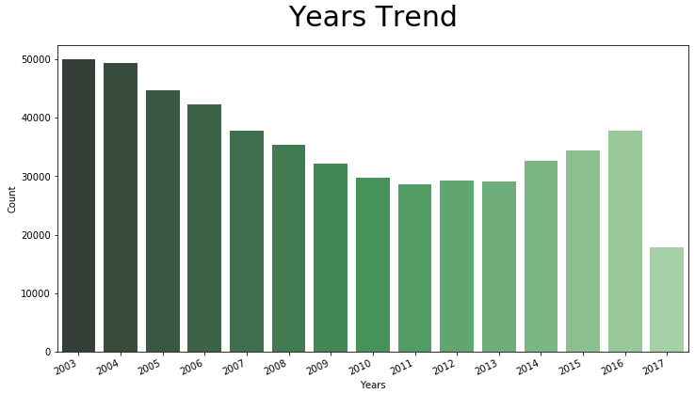
DATA EXPLORATORY ANALYSIS Prevalence of crime types: Number of count of crimes over the period of years from 2003 to 2017 was graphed using matplotlib inline

Slide 7
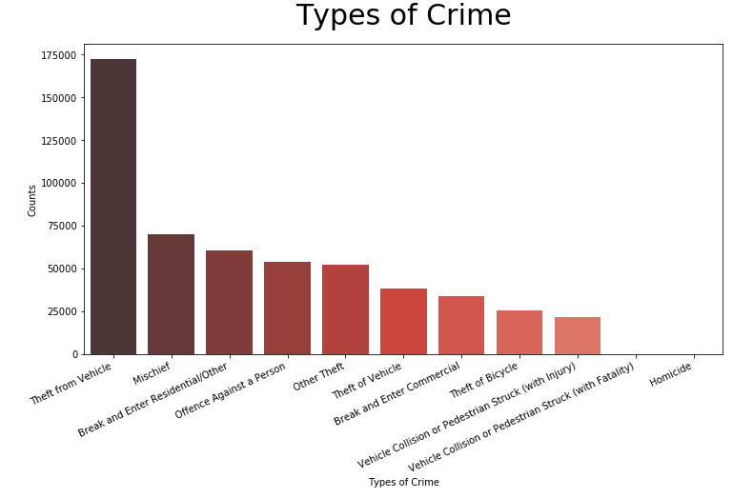
The counts of each type of crime was plotted and compared to see which crime is the most prevalent and which is least prevalent.

Slide 8
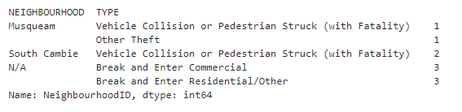
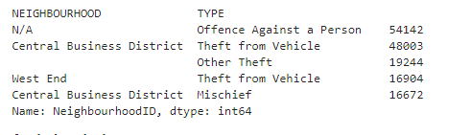
The most safe and unsafe areas were evaluated. This is done by df.groupby(['NEIGHBOURHOOD','TYPE']).count()['NeighbourhoodID'].sort_values(ascending=True).head(5) and as well as = False.

Slide 9
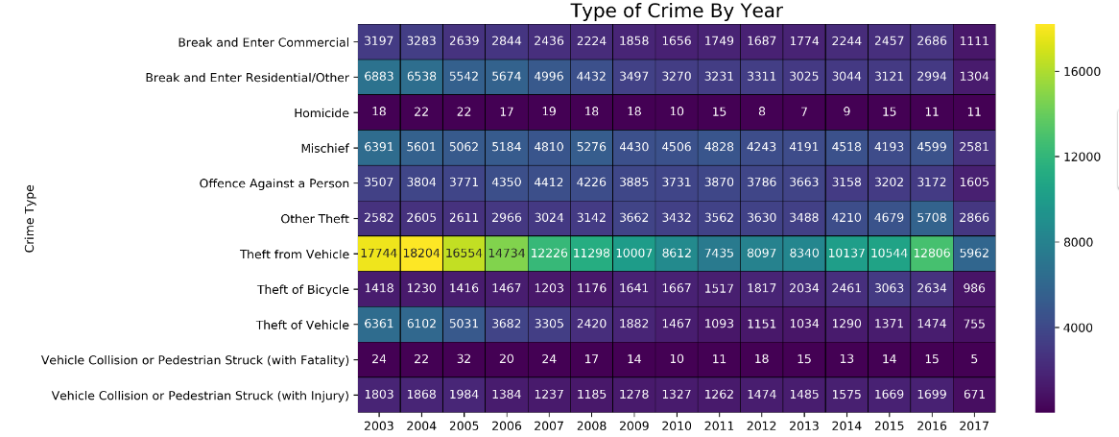
Then, heat map was analysed.

Slide 10
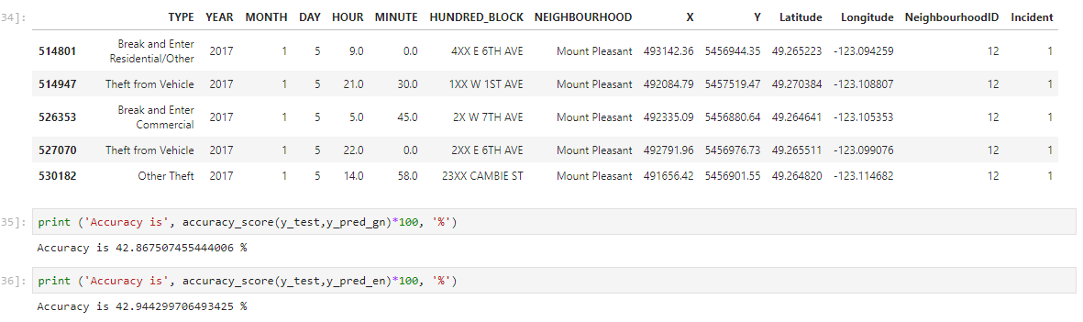
4) RESULTS The study portrays majority of the crime type, and crime trend over years, also we could predict the 2017 crime using Decision Tree Classifier. -By comparing the graphs, predominant type of crime is theft form vehicle, mischief, break and enter residential followed by others forms of crime. -During the years 2003 and 2004, highest crime rate was reported, and then gradually crime rate went down until 2011 then again it gradually went moderately up to 2016. the crime rate was lowest during 2017. -Musqueum and South Cambie were the safest places to buy houses to settle in Vancouver. -Central business district and Westend are the most unsafe places to buy houses to settle in Vancouver. Analysing the heatmap, -2010-2013 showed typically the lowest crime years. -Crimes such as collisions-Vehicle collisions, mischief and homicide show constant over the years. -Decision Tree Classifier gives a accuracy score of 42.86% and 42.94 % respectively.

Slide 11
5) DISCUSSION When I started this study, I initially was planning on to use API and execute k- means clustering to find clusters of safer regions, so that it would give a clear idea of map showing a safer cluster neighbourhood. My future work would be to find the safe region clusters. 6) CONCLUSION This report would be helpful for people planning to settle in Vancouver either temporarily for rent or for permanently settle in Vancouver by buying a house, by comparing the type of crimes in various locations, safe and unsafe areas, and crime trend. However, it would be necessary to analyze all variables such as cost of the house, size, rent amount, nearby grocery stores etc. Thus, further exploration is required.

Slide 12
Acknowledgements:
I immensely acknowledge
Kaggle for letting me use the data fromhttps://www.kaggle.com/wosaku/crime-in-vancouver
https://labs.cognitiveclass.ai/tools/jupyterlab/ for using the lab for writing the code as well as executing.
IBM and its resources and coursera platform and the most valuable teachers without which I could not have attained this knowledge in Data Science.
All other peers who gave valuable comments, clarifying the doubts as well as others who are part of this program.

